Slide 1
4
LEARNING FROM NATIONAL MDG REPORTS
Open Working Group, New York
December 2013
Shantanu Mukherjee, UNDP

Slide 2
THE MONITORING FRAMEWORK FOR THE MDGs
Timeline –
2000, Millennium Declaration (MD)
2001, Roadmap towards the implementation of the MD
2007, Revised monitoring framework from 2005 World Summit
Four new targets
Currently -
Eight goals, 21 targets, 60 indicators
Goals 1-7 cover 15 targets, 44 indicators

Slide 3
GLOBAL AND NATIONAL MONITORING
Differences in objectives
Globally
Comparable across countries; set incentives for national action; used for regional and global aggregates
Nationally
Advocacy and national ownership; policy design; challenges in country context; empowerment at UN debates and negotiations
Differences in mechanisms
Inter-Agency Expert Group
Annual reports
UNDP - scorekeeper of the MDGs at national level
Over 400 national MDG reports – government owned
Guidance for countries (2001, 2003, 2009, 2013, 2015)
Available information/data for emerging priorities, estimates for 2015 as baselines for next agenda

Slide 4
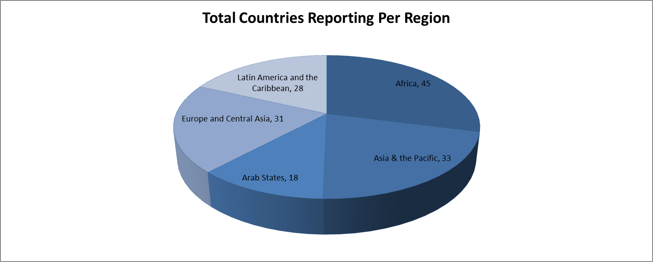
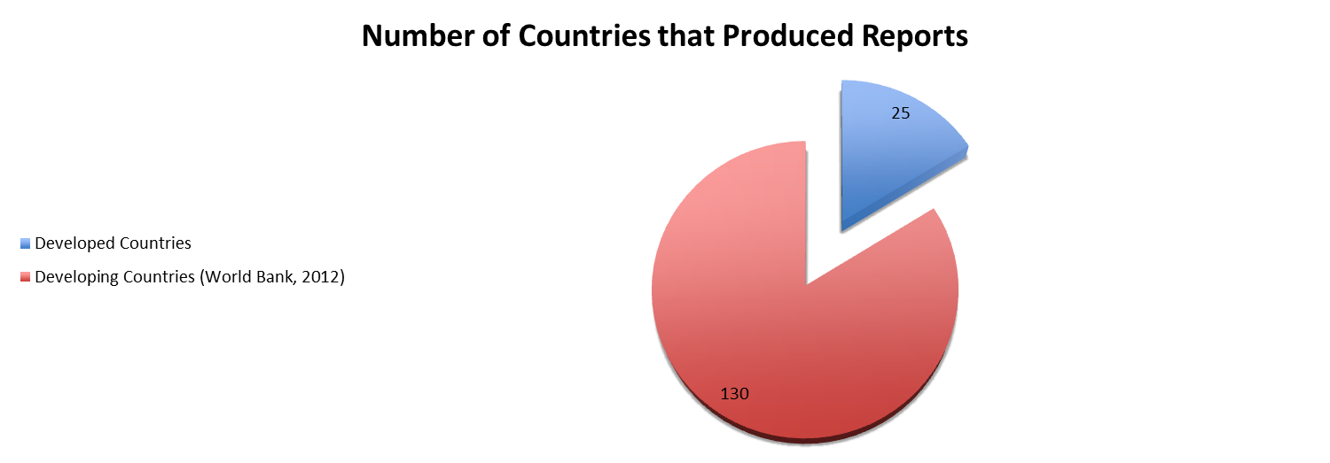
Notes:
Total Countries Reporting Per Region

Slide 5
GOALS, TARGETS AND INDICATORS
Goal – Ambitious, specific commitment; operational and easy to communicate
Targets – Quantified, time-bound outcome contributing to achievement of the goal
Can be global or national
Indicators – Quantified, objectively measurable metric (s) that can be used to assess
Progress towards the goal (outcome)
Express different dimensions of the goal
Intermediate steps that are expected to contribute significantly to progress
Obtained from different sources – surveys, administrative data, model estimates

Slide 6
EXAMPLE 1 – MDG 1
Goal – Eradicate extreme poverty and hunger
Targets –
Global – Halve, between 1990 and 2015 the proportion of people whose income is less than one dollar a day
National – ‘Reduce, from 20.4 to 8.8%, the proportion of people living in extreme poverty’ (Colombia)
Indicators –
Progress towards the goal (outcome)
Proportion below the poverty line – global, national
Express different dimensions of the goal
Inequality – share of poorest quintile in national consumption
Intermediate steps that are expected to contribute significantly to progress
Obtained from different sources – surveys, administrative data, model estimates

Slide 7
EXAMPLE 2 – MDG 5
Goal – Improve maternal health
Targets –
Global –
Reduce, by ¾ between 1990-2015, the maternal mortality ratio
Achieve, by 2015, universal access to maternal health
National – ‘By 2015, maintain the fertility rate at current levels, reduce the abortion rate by half and double the proportion of women using modern contraceptive methods’ (Serbia)
Indicators –
Progress towards the goal (outcome)
Maternal mortality ratio
Express different dimensions of the goal
Antenatal care coverage
Adolescent birth rate
Intermediate steps that are expected to contribute significantly to progress
Proportion of births attended by skilled health personnel
Obtained from different sources – surveys, administrative data, model estimates

Slide 8
REPORTING VARIES BY INDICATOR
Source: Own calculations based on developing countries’ national MDG reports at http://www.undp.org/content/undp/en/home/librarypage/mdg/mdg-reports/

Slide 9
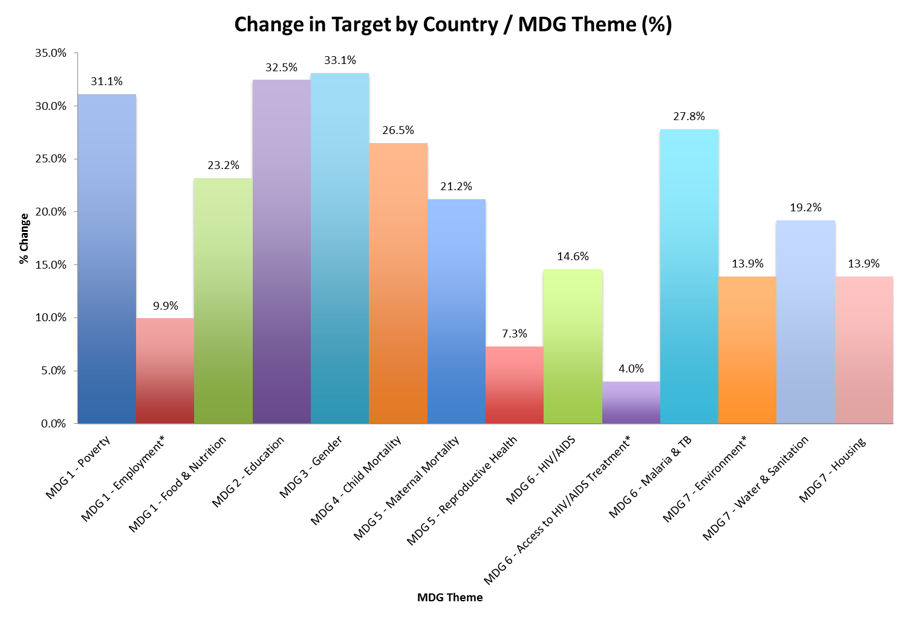
NATIONAL ADAPTATION CONSIDERABLE
Source: Own calculations based on countries’ national MDG reports at http://www.undp.org/content/undp/en/home/librarypage/mdg/mdg-reports/
Notes:
Sample of 151 countries including some classified as developed

Slide 10
CHANGING TARGETS, ADDING GOALS AND INDICATORS
MDG 2
‘Ensure that, by 2015, children everywhere, boys and girls alike, will be able to complete a full course of preschool and high school’ (Morocco)
MDG 3
‘Ensure that, by 2015, at least 50% women in economically active workforce’ (Tajikistan)
MDG 4
‘Reduce by half, between 2005 and 2015, the under-5 mortality rate in highland areas and selected northern and three southernmost provinces’ (Thailand)
MDG 6
‘Achieve by 2015, universal access to treatment and prevention of NCDs and control of major risk factors - smoking, alcohol use, obesity, physical activity, kava, by gender’ (Vanuatu)
MDG 7
‘Increase waste recycling ratio to 75%’ (Saudi Arabia)
‘MDG 9’
‘Zero impact of landmines and explosive remnants of war (ERW) by 2012’ (Cambodia)

Slide 11
DISAGGREGATING TO SUB-NATIONAL LEVELS
Initially – rural/urban, but increasingly by territory
2001-2005: 23%
2006-2010: 33%
30 countries more than once – including CAR, Congo, Djibouti as well as a number of MICs
Most frequent
Poverty, Hunger, Education, Child Mortality, Maternal Mortality, Water and Sanitation
Least frequent
Reproductive health, environment
Philippines, Indonesia, Colombia and some others also disaggregated goals and targets by region
Notes:
This requires more work to find each indicator that is more sub-national than others, but it is overwhelmingly 1.A. that is regionalized.

Slide 12
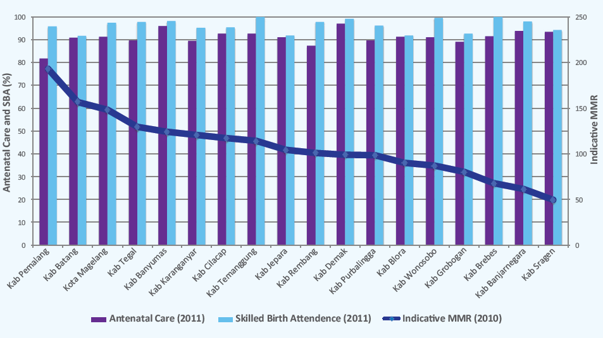
GUIDING POLICY THROUGH ADMIN DATA
Source – ‘Accelerating progress, sustaining results: the MDGs to 2015 and beyond’, UNDP, 2013.

Slide 13
THINKING AHEAD…
National priorities already being set (UNDP survey and 2013-2015 national MDG reports- ongoing)
Vision statements, perspective plans: several anticipate items likely to feature in future agenda
What are the data needs for supporting them?
Balancing national and global agendas
MDG model for adaptation was laissez faire – but allowed national adaptation and global reporting
Transitioning from global to national could need guidance – what targets could need this?
More universal targets likely
Eradicating poverty or universal school attendance
What are cost-effective methods for monitoring progress, globally and nationally
Targets could involve the need to balance trade-offs within and across goals
Indicators can motivate action (e.g. efficiency of water use in agriculture)
How to encourage universal reporting on such indicators?
Administrative data covers a spectrum
Process versus outcome indicators – how certain are the theories of change?
What are good criteria for their use? -mapping, defining and increasing reliability and objectivity
Using and validating data linked to new technology
Pace of change has increased, as has demand for more timely data; GIS, internet, mobile phones
How best does ‘big’ data complement ‘small’ data?
Notes:
This requires more work to find each indicator that is more sub-national than others, but it is overwhelmingly 1.A. that is regionalized.

